Slide 1
E – retail factors for customer activation and retention: A case study from Indian E – commerce customers.

Slide 2
Contents
Problem Statement & Objective
Literature Review
Data Visualization
Conclusion

Slide 3
Problem Statement
E-retail factors for customer activation and retention: A case study from Indian e-commerce customers
Customer satisfaction has emerged as one of the most important factors that guarantee the success of online store; it has been posited as a key stimulant of purchase, repurchase intentions and customer loyalty. A comprehensive review of the literature, theories and models have been carried out to propose the models for customer activation and customer retention. Five major factors that contributed to the success of an e-commerce store have been identified as: service quality, system quality, information quality, trust and net benefit. The research furthermore investigated the factors that influence the online customers repeat purchase intention. The combination of both utilitarian value and hedonistic values are needed to affect the repeat purchase intention (loyalty) positively. The data is collected from the Indian online shoppers. Results indicate the e-retail success factors, which are very much critical for customer satisfaction. Be careful: There are two sheets (one is detailed) and second is encoded in the excel file. You may use any of them by extracting in separate excel sheet. The number of column(s) is more than 47. Read the column header carefully.

Slide 4
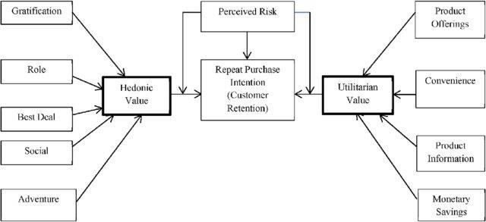

Slide 5
1. What is Customer Retention?
Customer Retention refers to a company’s ability to turn customers into repeat buyers and prevent them from switching to a competitor. It indicates whether your product and the quality of the service please your existing customers. 3 Customer Retention strategies are the processes and initiatives businesses put in place to build customer loyalty and improve customer lifetime value.

Slide 6
2. Why is customer retention important?
Customer retention increases your customers’ lifetime value and boosts your revenue. It also helps you build amazing relationship with your customers. You aren’t just another website or store. They trust you with their money because you give them value in exchange. According to the Harvard Business Review, acquiring a new customer can be 5 to 25 times more expensive than holding on to an existing one. You don’t need to spend big on marketing, advertising or sales outreach. It is easier to turn existing customers into repeating ones, since they already trust your brand from previous purchases. New customers, however, often require more convincing when it comes to the initial sale.

Slide 7
3. Customer Retention benefits:
• Retention is Cheaper than Acquisition
• Loyal Customers are more profitable.
• Your Brand will stand out from the crowd.
• Engage customers provide more feedback.
• Loyal customers are more forgiving.
• Customers will explore your brand

Slide 8
.Exploratory Data Analysis
There are 269 rows and 71 columns.
There are no missing values in the dataset.
There are unwanted characters in columns.
There are 70 object type variable and one is int64 variable, however it is also categorical in nature.

Slide 9
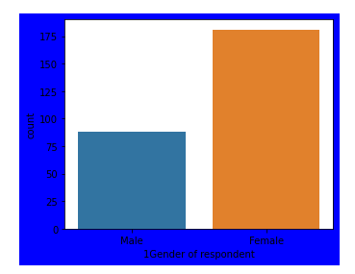
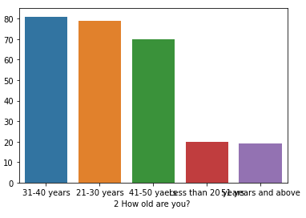
EDA- Exploratory data analysis Gender of respondent , How old are you
81 of the customers are from age group 31-40 years.
79 of the customers are form age froup 21-30 years.
70 of the customer are from age from 41-50 years
20 of the customer are less then 20 year old
19 of the customer are above 51 years old
Here we can see that Gender of respondent is ,
Male - 88
Female - 181
Notes:
d

Slide 10
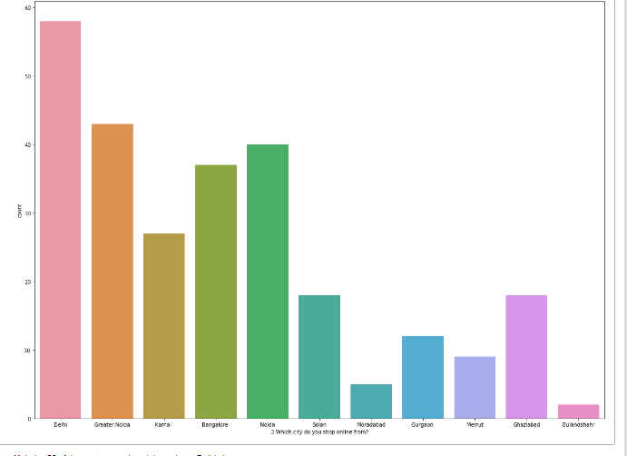
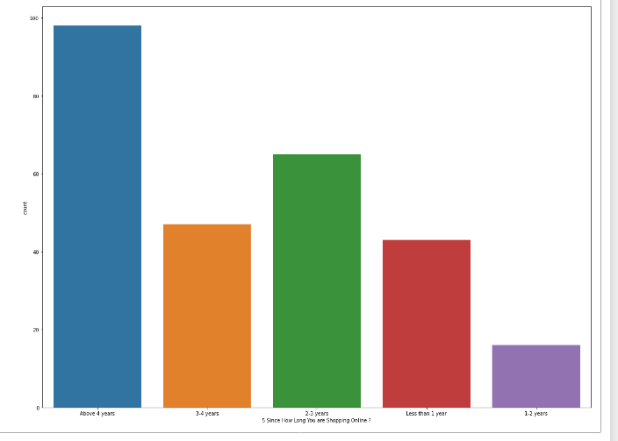
EDA – EXPLORATORY DATA ANALYSIS Which city do you shop online from , Since How Long You are Shopping Online
Majority, 58 of the customers placed the order at Delhi city
More then 4 years - 98 people are using
3 - 4 Years - 65
2 - 3 Years - 47
Less the One Year - 43
1-2 Year - 16

Slide 11
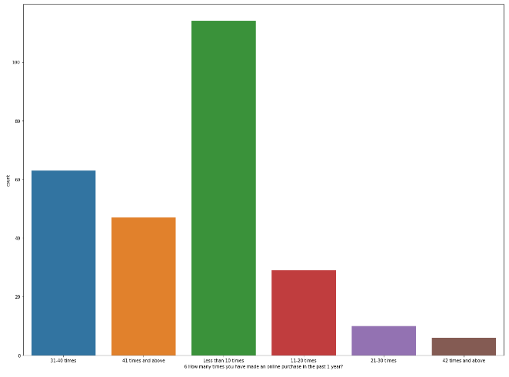
EDA – EXPLORATORY DATA ANALYSIS How many times you have made an online purchase in the past 1 year?
Less than 10 times - 114 People
31-40 times - 63 People
41 times and above - 47People
11-20 times - 29 People
21-30 times - 10 People
42 times and above - 6 People

Slide 12
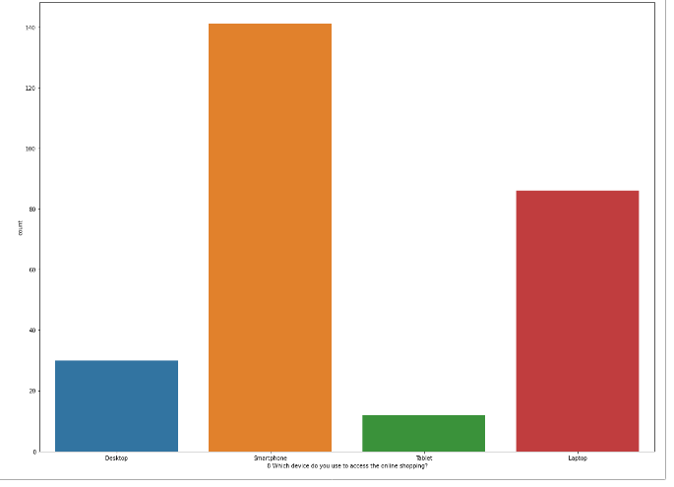
Eda – exploratory data analysis Which device do you use to access the online shopping
Smartphone 141 Peoples
Laptop 86 Peoples
Desktop 30 Peoples
Tablet 12 Peolpls

Slide 13
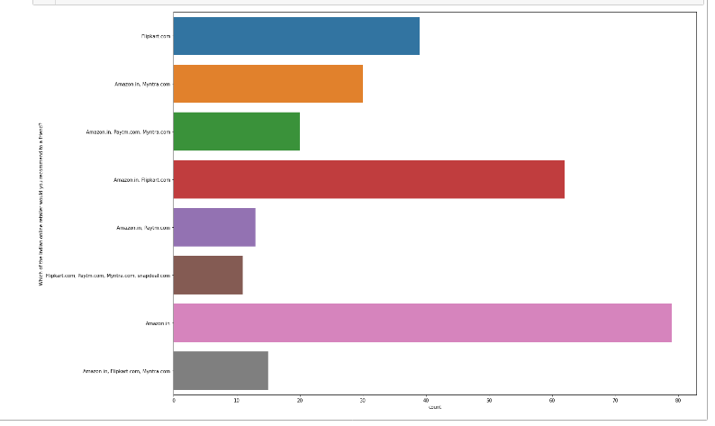
Eda- exploratory data analysis Which of the Indian online retailer would you recommend to a friend
CONCLUSION
Amazon is recommended by 81.4% of the customers.
Snapdeal is recommended by 4.1% of the customers.
Flipkart is recommended by 47.2 of the customers.
Myntra is recommended by 28% of the customers.
Paytm is recommended by 16% of the customer

Slide 14
Conclusion
As according to the dataset best online retailer they would recommend to a friend . Most of the respondents says Amazon because . It is providing all the feature that user want . Website is efficient and it is fast loading . it give complete relevant description and information of products. it is reliable and quick to complete the purchase . Amazom give speedy delivey to some places . customer and there is several payment option available . on the website . it provide online assistance through multichannels. providing good details on product . Amazon user friendly interface and has visual appealing webpage layout . Amazon also offers wide variety of product and its application is easy to use . Lastly the main thing why user recommend it is because of its trustworthiness and also its robust security in protecting customer financial information and their Privacy Information . Frequent distribution when moving from one page to another this company should see and improve it to give overall best experiance to the users . This paper investigated the factor that influence the online customer repeat purchase intenstion . During the process various data processing method has been used to clean the data . The project conatains EDA considering every aspect . The major finding is complete relevant description if products and reliability of the website increase chances of customer retetion. Howevee , if the content on the website is not easy to read and understand or can't guarantee the privacy of the customer will lead to chances of the customer retention . This project has increased my understanding of the concept . During the research i cam across various challenge and while solving them i learned a lot of new thing . How to plot different charts . . For example i learned how to plot subplot . How to How to group data and visualize that.

Slide 15
THANKYOU…

